Slide 1
Chapter 15 Identifying Failure & Repair Distributions
Parameter Estimation
maximum likelihood estimator
Notes:
This chapter along with Chapter 16 develops a methodology for fitting a theoretical probability distribution to a set of failure or repair data.

Slide 2
Maximum Likelihood Estimation (MLE)
Find estimates for the distribution parameters which
will maximize the probability of obtaining the observed
sample times.
Max f(t₁) f(t₂) . . . f(t_{r})
Notes:
While least-squares can be used to estimate distribution parameters, a more preferred method is to use Maximum Likelihood Estimator (MLE).

Slide 3
Why MLE’s????
1. MLE’s are invariant:
2. MLE’s are Consistent:
3. MLE’s are (best) asymptotically normal:
4. Required for certain tests such as the Chi-Square GOF test.
Has an intuitive appeal.
Can accommodate censored data
Notes:
Several reason why MLE are preferred. Note, however, that a couple of the properties of MLE are large sample size (asymptotic) properties.

Slide 4
MLE - Geometric Distribution
Let X = a discrete random variable, the number of trials
necessary to obtain the first failure. Assume the probability
of a failure remains a constant p and each trial is independent,
then:
Prob{X=x} = f(x) = (1-p)^{x-1} p, x = 1, 2, ... , n
Notes:
Understanding the MLE concept is easier with a discrete probability distribution. A function is constructed that provides the probability of obtaining the sample x₁, x₂ , … x_{n} as a function of the parameter(s). This function is then maximized with respect to the parameter(s) in order to maximize the probability of obtaining the observed sample. In other words, we assign a value to the parameter that maximizes the probability of generating the sample that was actually observed.

Slide 5
Geometric Distribution
Notes:
In general, a optimization problem must be solved to find the MLE.

Slide 6
Example 15.13
The following data was collected on the number of
production runs which resulted in a failure which
stopped the production line: 5, 8, 2, 10, 7, 1, 2, 5.
Therefore, X = the number of production runs necessary
to obtain a failure.
Mean = 1/p = 40/8 = 5
Pr{X = 3} = .8² (0.2) = 0.128
Notes:
An example to find the MLE for a discrete geometric distribution.

Slide 7
Likelihood Function
maximize the log of the likelihood function:
for Type I (right censored) data:
for Type II, t_{r}
Notes:
The function that is to be maximized is called the likelihood function since it provides the probability (likelihood) of generating the actual sample. For a continuous distribution, the density function evaluated at the i^{th} failure time, t_{i}, is used in place of the probability mass function. For censored data, the probability that no failures will occur (i.e. reliability) before the censored time must be included in the likelihood function.

Slide 8
Exponential MLE - Type II data
Notes:
The above derives the MLE for the exponential when Type II censored data is present.

Slide 9
Exponential MLE - Type II data
Type I, use t*
Notes:
Continuing the derivation. For Type I data, replace t_{r} with t*. The MLE for the lambda is simply the total time on test divided into the number of failures. The MLE for the MTTF is the total time on test, T, divided by r, the number of failures.

Slide 10
Total Time on Test - CFR
n = nbr on test
r = nbr failures
k = nbr multiply censors
t_{i} = failure time
t_{i}⁺ = censor time
t* = test time (Type I)
t_{r} = test timr (Type II)
MTTF = T / r
Notes:
For the CFR model, the total time on test is given by the above table under a variety of test conditions.

Slide 11
Weibull MLE - Type II Data
Notes:
Deriving the Weibull MLEs under Type II testing.

Slide 12
Weibull MLE - singly censored
Notes:
Beta and theta in the above equations cannot be solved for analytically. Instead, the first equation must be solved numerically for beta-hat. Once beta-hat is found, then theta-hat can be solved for using the second equation.

Slide 13
Newton-Raphson Method
where
Notes:
The Newton-Raphson iterative method for finding the solution to a nonlinear equation is often used to solve for Beta-hat.

Slide 14
Normal & Lognormal MLEs complete data
NORMAL
LOGNORMAL
recall:
Notes:
The MLEs for the normal (and hence lognormal) are well known when complete data is present.

Slide 15
Example 15.16
Ex. 15.8: 47.1, 84.8, 151.9, 122.5, 218.2, 99.6, 59.8, 138.8,
213.5, 53.4,102.4, 100.8, 230.1, 104.6, 61.5, 122.1, 186.2,
498.4, 77.0, 78.7,112.3, 44.0, 151.3, 151.3, 222.8
L-S estimates: t_{med} = 116 and s = .613
μ = (ln 44 + ln 47.1 + ... + ln 498.4)/25 = 118.8/25 = 4.752
t_{med} = e^{4.753} = 115.932
s² = [(ln 44 - 4.752)² + (ln 47.1 - 4.752)² +
... + (ln 498.4 - 4.752)²]/25 = .31798
s = .5639.
Notes:
An example to find the MLEs for the lognormal distribution.

Slide 16
MLE with Multiply Censored Data
prob of failure
occurring at time t_{i}
prob of failure
occurring after time t_{i}⁺
F = set of indices for failure times
C = set of indices for censored times
(including singly censored times)
Notes:
When multiply censored data is present, the likelihood function is based upon the above.

Slide 17
MLE Exponential - multiply censored data
T
Notes:
For the exponential distribution with multiply censored data, the MLE is still total time on test divided into the number of failures. Total test time includes both time to failure and time to censor (removal).

Slide 18
MLE Weibull multiply censored data
Notes:
The derivation of the MLEs for the Weibull with multiply censored data.

Slide 19
MLE Weibull - multiply censored data
solve
numerically
monotonically
increasing RHS
Notes:
Again, we end up with a nonlinear equation in Beta to solve for.

Slide 20
Example 15.17
Fifteen units were placed on test for 500 hours. The
following failure times and censor times were observed
prior to concluding the test:
34 136 145+ 154 189 200+ 286 287 334 353 380+
For the exponential,
T = 34+136+145+154+189+200+286+287+334+353+380+4(500)
= 4498 and the MLE for the MTTF = T/r = 4498/8 = 562.25.
For the Weibull, the 4 units which had not failed by the end
of the test are assigned censored times of 500 hours. The left hand side of MLE Eq. equals 5.21385. Beginning with
β = .1 and increasing β in the right hand side by .01 until it
exceeds 5.21, results in β = 1.43. Then θ = 491.
Notes:
Use the course software to find the MLE for the exponential and Weibull based upon the above censored data.

Slide 21
Example 15.17
exponential:
R(100) = .837
Gosh!
Which is the
correct
model?
Weibull:
R(100) = .902
Notes:
Two models. Which should be used? Chapter 16 will tell us. We can hardly wait!

Slide 22
Normal Distribution - Censored Data
Maximize using a
Numerical search algorithm

Slide 23
Minimum Extreme Value Distribution
Complete or right censored data
Likelihood function:

Slide 24
Minimum Extreme Value Distribution

Slide 25
Minimum Extreme Value Distribution
Complete data
Method of Moments:

Slide 26
Gamma Distribution
Complete data, likelihood function:
Substituting for α:
Maximize directly

Slide 27
Gamma Distribution
Complete data
Method of Moments:

Slide 28
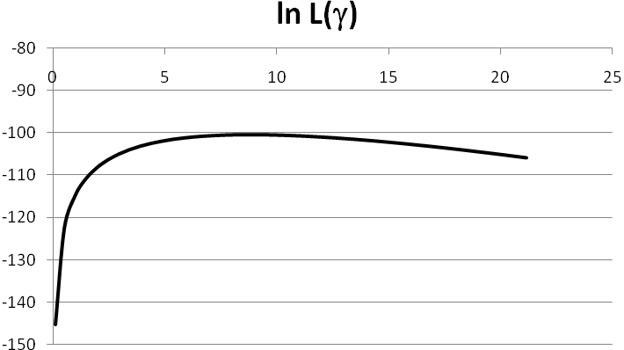
EXAMPLE 15.20
Twenty units believed to have a gamma distribution were placed on an accelerated life test with failures in days occurring at the times shown: 152 152 115 109 137 88 94 77 160 165 125 40 128 123 136 101 62 153 83 69. Using Excel Solver,
The corresponding method of moments estimators are

Slide 29
Parameter Estimation for Interval Data
n_{j} , is the number of failures that occur within the interval (a_{j-1}, a_{j}) where j = 1, ,…,k. Any right censored units are counted in the interval (a_{k}, ∞). The likelihood function can be stated as

Slide 30
EXAMPLE 15.21 (Weibull)
Monthly failures of fifty units in operation were recorded over a six month period with the following results:
Month | Upper bound in days | Number of Failures
1 | 30.0 | 10
2 | 60.0 | 11
3 | 90.0 | 7
4 | 120.0 | 4
5 | 150.0 | 3
6 | 180.0 | 2

Slide 31
EXAMPLE 15.21 (Weibull)
Using Excel Solver, maximize

